Slide 1
Fine Motor Control and Functional Strategies to Develop these Skills
Presented by: Nicole Spinoso, OTR/L

Slide 2
SENSORY MOTOR DEVELOPMENT
Sensory integration is the process through which our brain receives, organizes and interprets information from our senses.
Our senses include sight, smell, taste, hearing and touch.
We have two other special senses - Proprioception (sense of body position) and Vestibular (sense of movement).
Later in development the child will develop equilibrium responses, weight shifting and more complex movement patterns, differentiation of the right and left sides of the body (typically well established by 6-7 years old) and gradually the child learns to project internalized spatial concepts to the outside world.

Slide 4
PRECURSORS TO EFFICIENT FINE MOTOR CONTROL
Prior to being able to engage in fine motor activities, children need well developed:
Postural control: ability to sit upright in a chair and stabilize body while moving arms
Upper extremity control: ability to move with precision and vary the strength and force of movement
Hand developmental milestones: include good arch development, dissociation between the two sides of the hand, wrist extension, and strength in the small musculature of the hand.

Slide 5
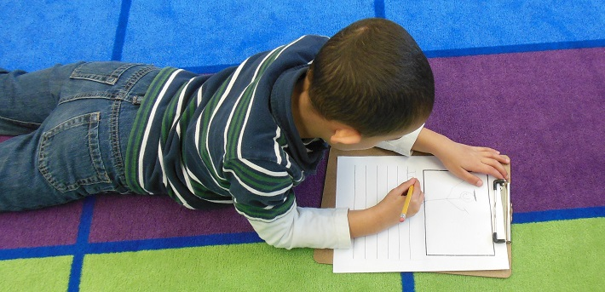
ACTIVITIES TO DEVELOP POSTURAL CONTROL IN THE CLASSROOM
Play in prone (on your belly)
Use dynamic seating surfaces such as Move-N-Sit cushions, Stools, ball chairs, etc.
Make Yoga a part of your daily routine

Slide 6
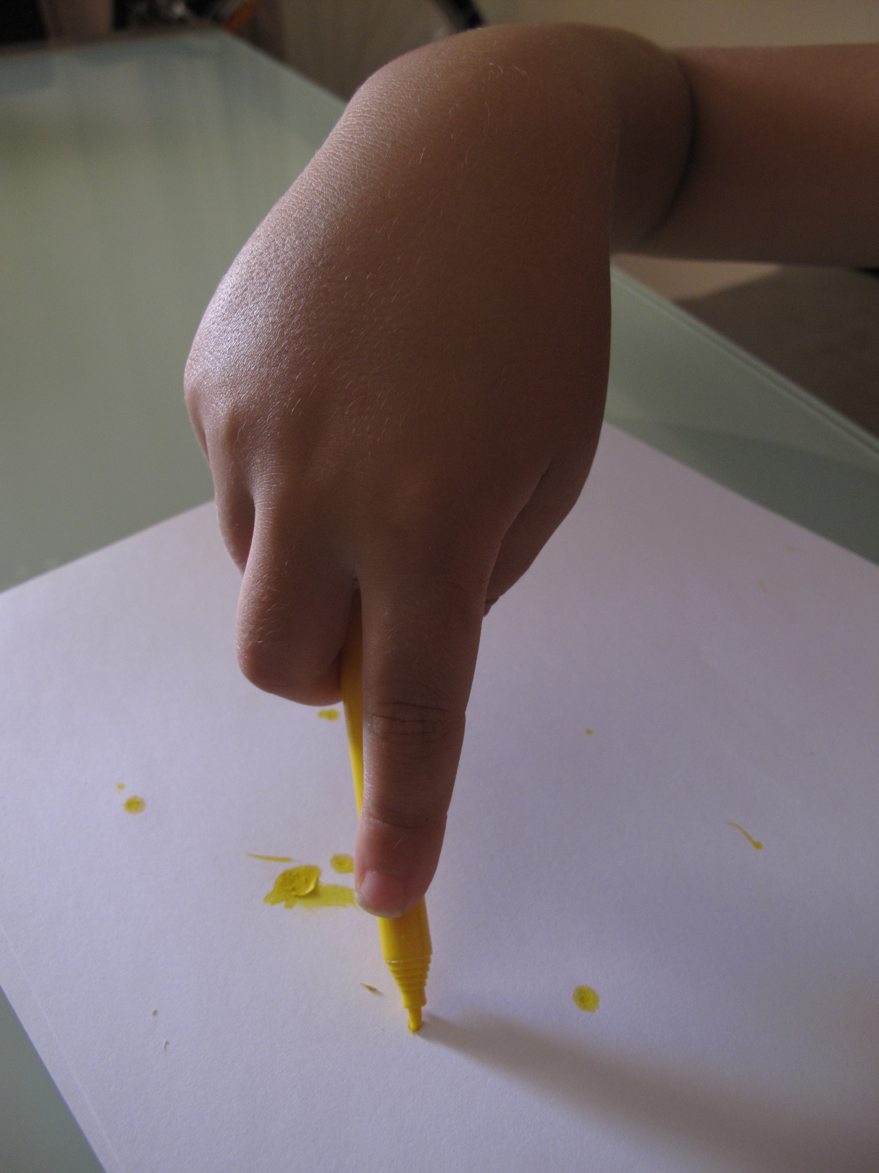
GRASP PATTERNS Children will start showing a hand preference by 3 to 4 years old yet may still switch hands. Dominance is typically established between 4 to 6 years old.
2-3 year old's will use a DIGITAL PRONATE GRASP, which is the beginning of a proper looking hand grasp. (Prior to this is a fisted grasp pattern). The fingers are now pointed down towards the bottom of the writing utensil, however all the fingers are being used along with a lot of whole arm movements.

Slide 7
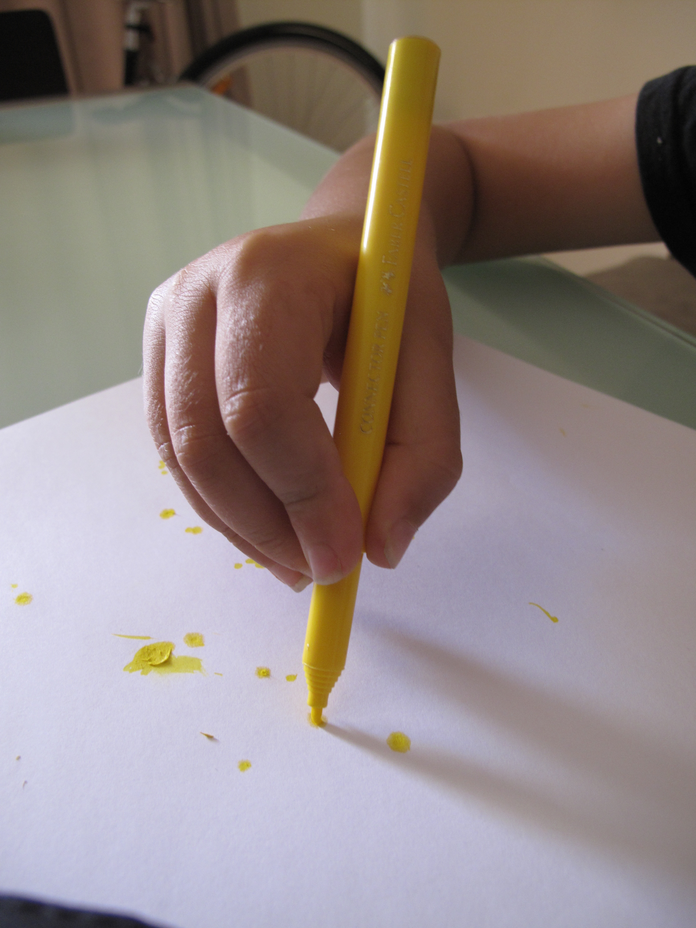
3-4 years old's will switch to a STATIC TRIPOD GRASP or QUADRUPOD GRASP. They hold the writing utensils crudely and use the whole pads of their fingers on the writing utensil. Movements originate from arm and shoulder as a whole unit.

Slide 8
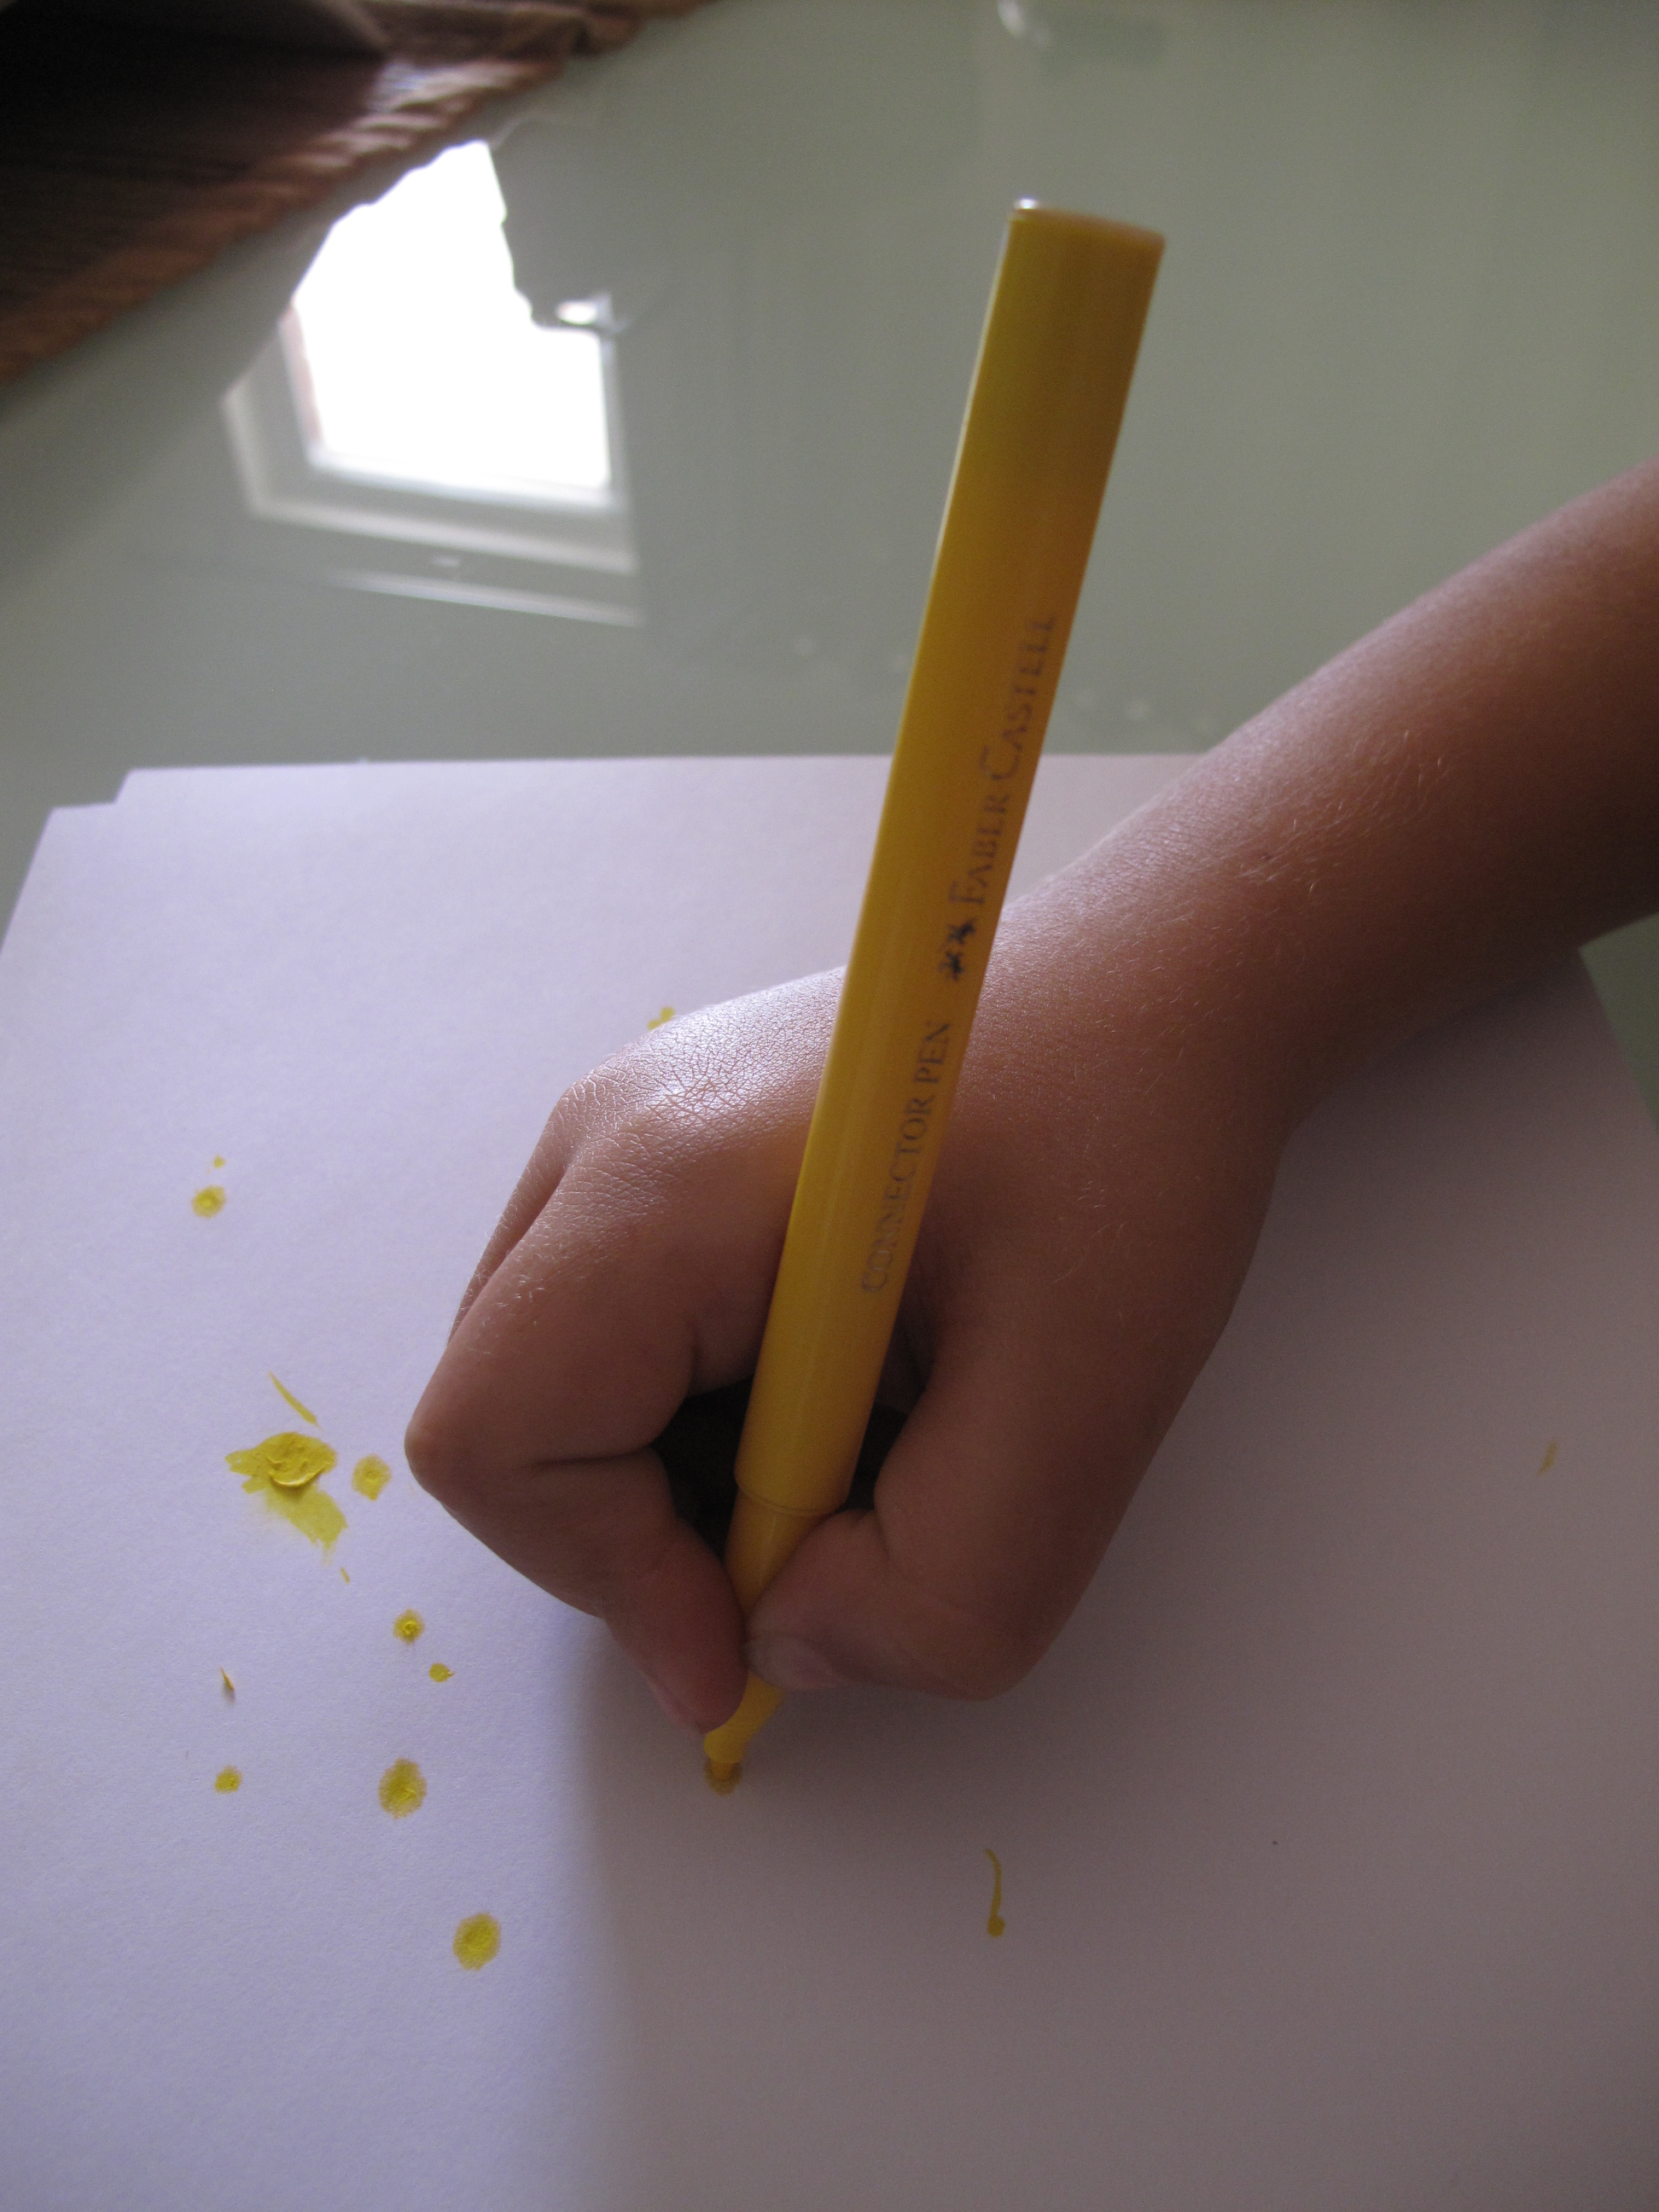
4 to 6 years old's will use the most mature grasp, the DYNAMIC TRIPOD /QUADRUPED GRASP, when they use the tips of their fingers on the writing utensil and also hold the crayon/pencil more at an angle than vertical. Their wrist movements are also dynamic, which means they move back in forth without any full arm movement. As the fingers begin to move independently, the ring and little fingers gently curl into the palm, the web space opens and becomes more circular, the writing tool is held closer to the tip and movement of the writing tool comes from the fingertips.

Slide 9
WHAT GRASPS ARE ULTIMATELY CONSIDERED FUNCTIONAL
Researchers have found that there are actually 5 different functional grasp patterns. Children in higher elementary grades who use these grasp patterns are able to write with fluidity and speed, without fatigue and discomfort.

Slide 10
What to look for:
Pencil held closer to the fingertips - not mid-finger or palm
Weight bearing through the forearm, not arm up in the air
Hand being placed closer to the point than mid-shaft of the pencil
Movements originating from the wrist and fingers, not the elbow and shoulder.
Strategies:
SMALL crayons and golf pencils (broken crayons)
Activities and games that encourage a pincer grasp pattern (small pegs, tweezers, clothes pins, etc.)
Drawing and coloring in a more vertical position such as on an easel or slant board. This helps with forearm weight bearing and wrist positioning.

Slide 11
Technology and Fine Motor Skills:
A study undertaken in Taiwan and published in 2017, compared two groups of children. The one group were exposed to Apps which was claiming as having the potential to improve fine motor skills. The other group were given traditional materials like threading and lacing, scissors, and play dough, amongst others.
The findings revealed that the group who had used traditional materials to enhance fine motor skill development achieved “significantly greater changes in fine motor precision, fine motor integration, manual dexterity and pinch strength than did those in the touch screen group.”

Slide 12
The repetitive fine motor movements used on the tablet don’t require or promote the development of hand strength. Studies have shown that both male and female millennials have weaker hand strength than their counterparts 30 years ago.
We need our hands to develop a wide variety of manipulatory skills, movement repertoires, and strength. If we consider the taping sweeping, dragging and zooming that are required to engage with a tablet or iPad, we need to ask if this covers the skills needed by our hands to perform the most basic of fine motor skills such as buttoning our jeans, through to the high-level manipulation required to master handwriting?

Slide 13
Research has shown that handwriting – specifically the sequential finger movements required to move the pencil during the actual handwriting process – activates the memory centers of the brain.
This is why we remember things better when we write them down. The movement of our fingers during the handwriting process wakes up the memory centers, along with the language centers, in our brains.
We remember less when we type things than when we write them – this is true for both adults and children. When we type, we are just pressing a key down and this doesn’t activate those centers.

Slide 14
DEVELOPMENT OF SCISSOR SKILLS
Scissor skills require good postural control for sitting upright, the ability to stabilize body parts proximally while move distally, isolate your thumb and digits, and bilateral coordination.
Milestones:
2 to 2.6 years - can hold a scissor and open and close it but is not ready to start cutting paper
2.6 to 3 years - develops thumb isolation, can start snipping and may be able to cut across a 6-inch piece of paper
3 to 3.6 years - begins to use the “helping hand” to hold the paper, can cut across a straight line with typical deviation of ½ inch.
4 years - cuts on a line within a ¼ inch and is starting to cut curved lines
4.5 to 5 years – can cut a circle and square

Slide 15
Strategies:
Check for good sitting posture
Encourage thumbs up position (I will often put masking tape on the thumb loop as a visual)
Some tables are too high so I will pull the child away from the table and teach them to cut in front of their body.
If the upper arm is up in the air teach them to stabilize their upper arm against their trunk.
Start with cutting on thicker paper such as index cards

Slide 16
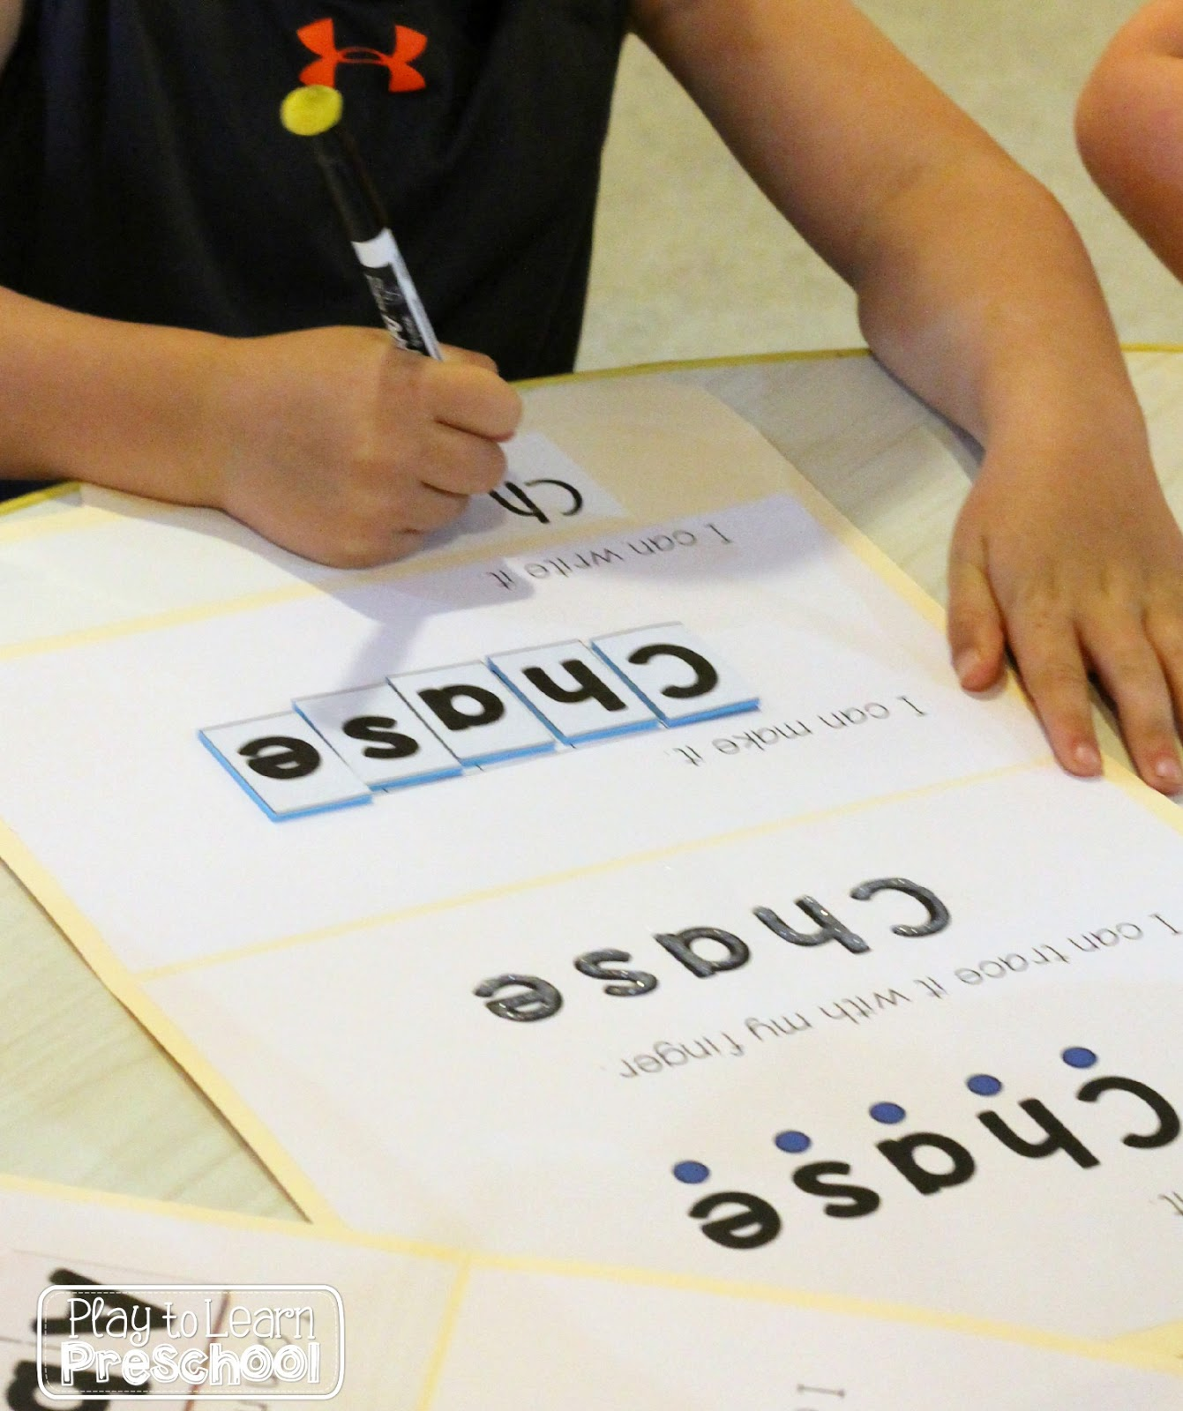
HANDWRITING
In my research I found that there are varying thoughts on; “Is teaching handwriting in pre-school developmentally appropriate?”
I took a poll on what teachers expects from a child entering kindergarten – The answer: teachers said their expectation is that the student should know how to approximate their name.

Slide 17
SUGGESTIONS FOR HANDWRITING
Present activities that focus on upper and lowercase letter recognition
Focus on pre-writing activities such as shapes and line directionality and spatial relations
Focus on proper formation using a variety of media to practice; play dough, shaving cream, sand, puffy paint, dot paint, stickers
When teaching to write their name, teach with proper case.

Slide 18
STATIONS IN THE CLASSROOM
Set up stations that address fine motor development with other functional/curricular areas
ADL station- include dressing dolls, dressing vests, laces and tying knots
Sorting station- use tongs to sort objects by color, size, and shape, sort coins with palm to finger translation
Math station- counting popsicle sticks and then put rubber bands around them, use pop-poms with tweezers to count
Coloring and tracing station – coloring shapes with raised boundaries such as Wikki Stix, tracing basic lines and curves

Slide 19
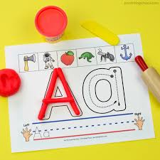
Letter station- Instead of just writing, have cards for them to use Playdoh to roll into shapes of letters, clothespin letter match, Wikki Stix Alphabet
Coloring station- use Wikki Stix for boundaries, color while prone on the floor
Play stations- Lego Jr or Duplo sets, marble race games, Playdoh, games with manipulatives, Pick Up Sticks with colored toothpicks. Teachers Pay Teachers- COTA life- Fine Motor Gameboards

Slide 20
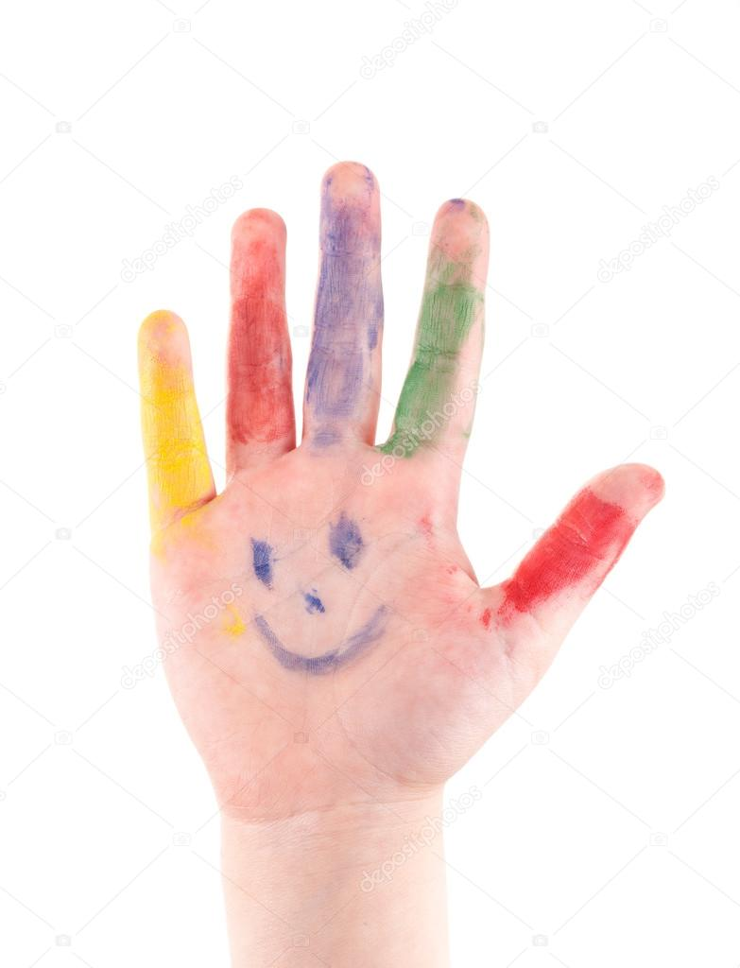
RESOURCEFUL WEBSITES
Yourtherapysource.com
www.skillbuildersonline.com
www.growinghandsonkids.com
www.thesuperteacher.com
www.superduperinc.com
www.thehappyhandwriter.co.za
You tube- OT Closet

